Slide 1


Azure Functions
PowerShell

Slide 2




Hello!
Thank you for joining us today
Speaker: Luke Murray
Senior Consultant, , New Zealand
Microsoft Azure MVP from Hamilton, New Zealand
https://x.com/lukemurraynz
https://www.linkedin.com/in/ljmurray/
https://luke.geek.nz/

Slide 3

Let’s discuss Azure Functions
Introduction
Create your first Azure Function
Azure Functions
Azure Functions and PowerShell
Deploying to Azure
Configuring Development environment
Conclusion

Slide 4
Introduction

Slide 5
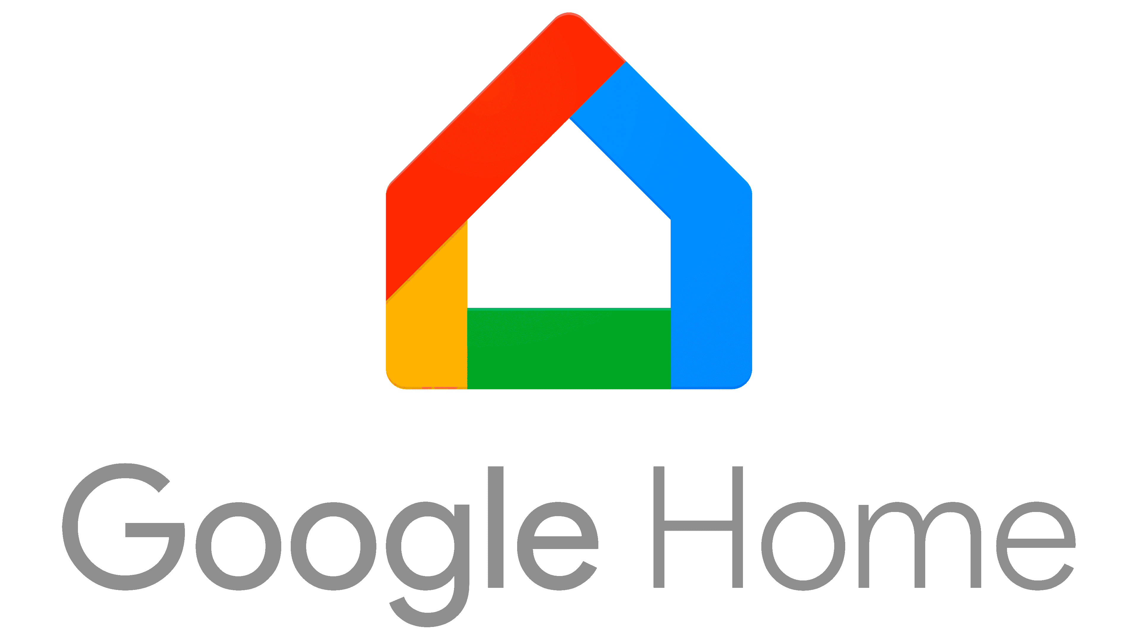





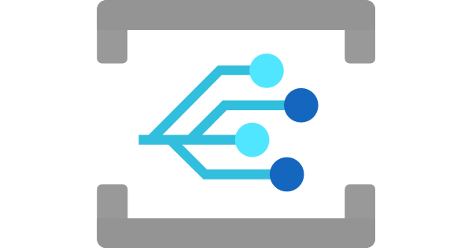








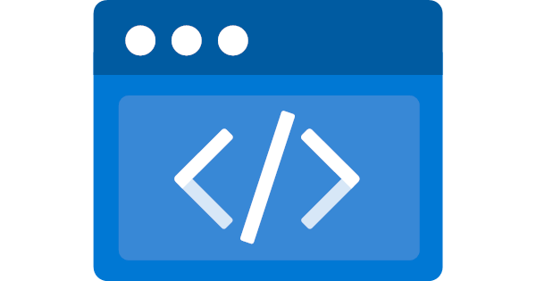



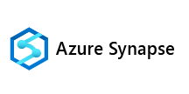
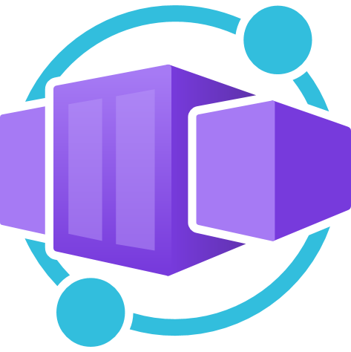



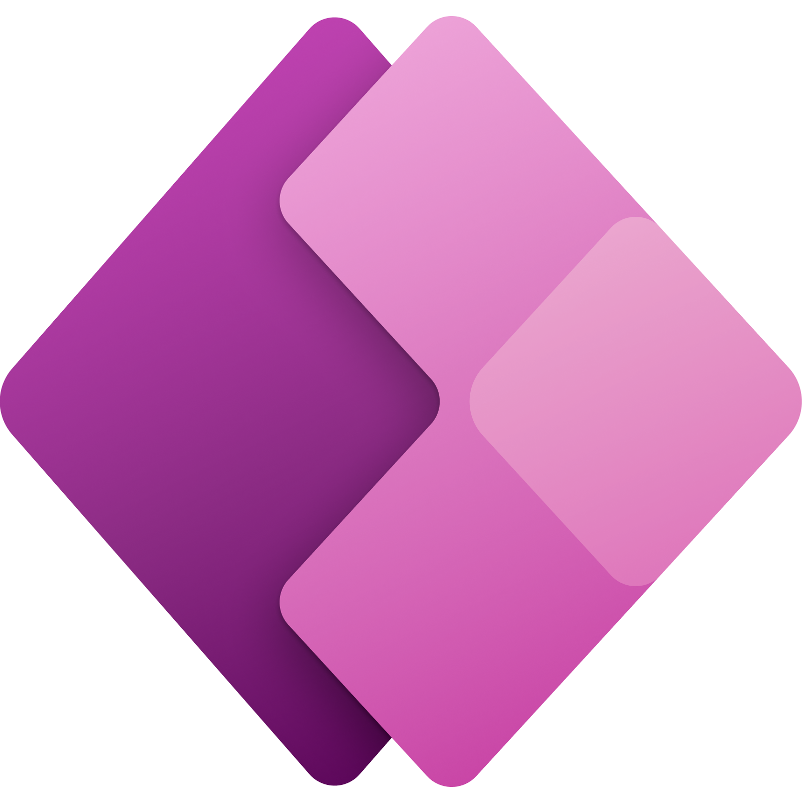

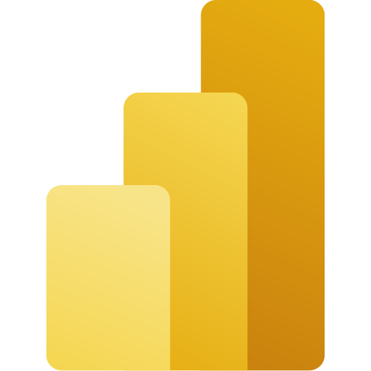



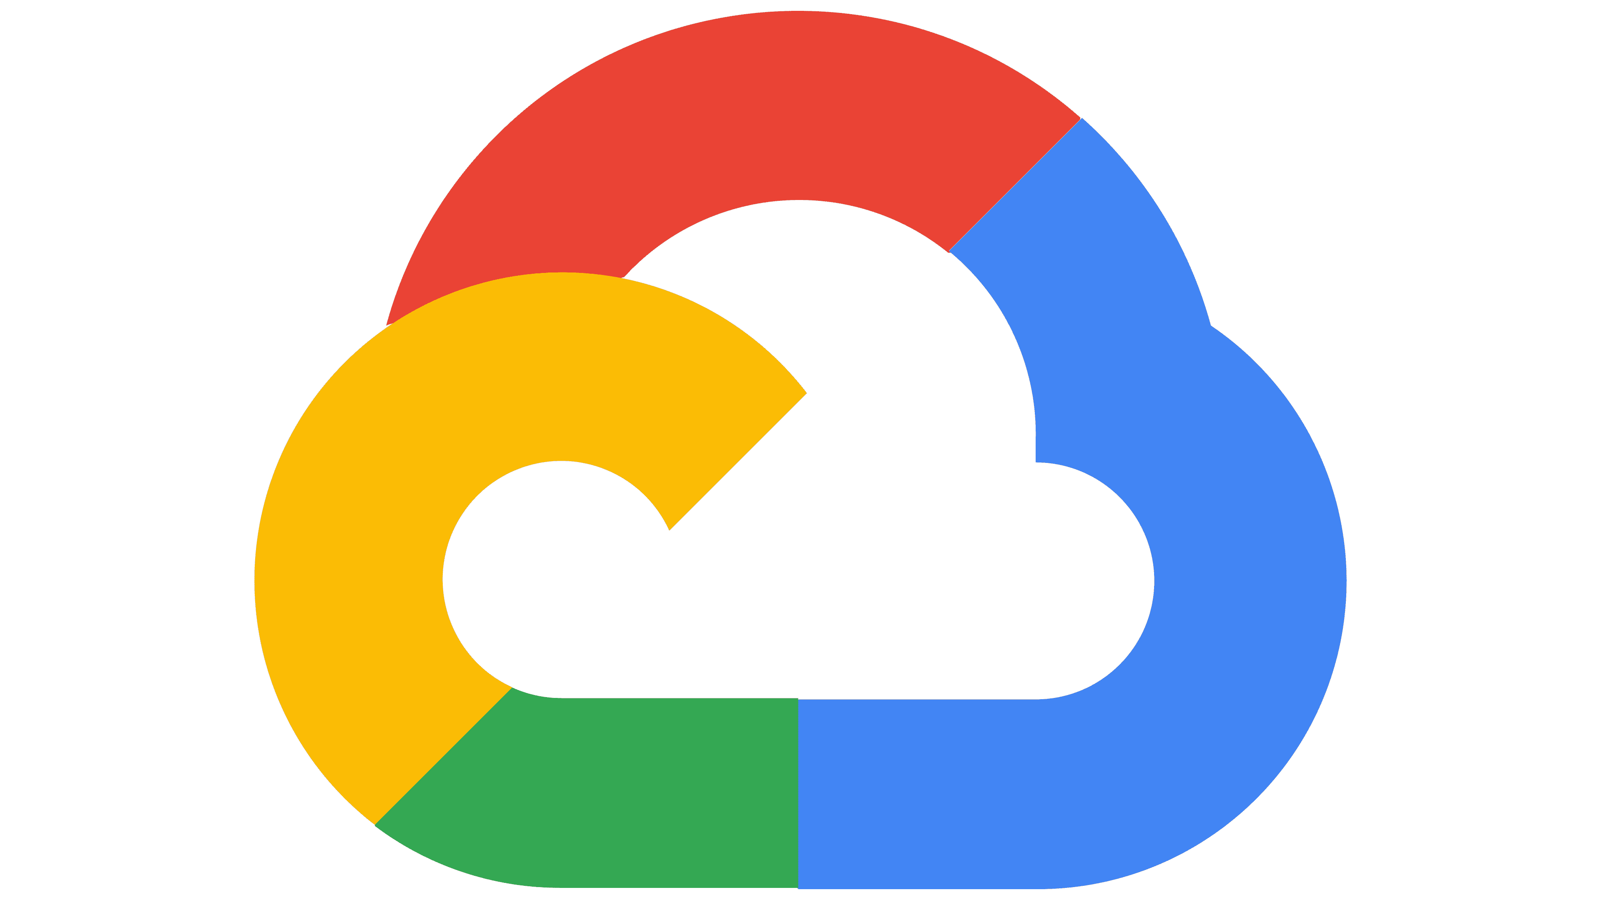
Google Home
Apache Kafka
IoT Hub
AI
APIM
Integration
AI Studio
Event Hub
Event Grid
Amazon Alexa
Azure Functions
Elastic Search
Serverless on Azure
Logic Apps
OpenAI
Azure AI
FHIR API
Deploy alongside
Serverless
Process your events and data anywhere on-the-go
Azure Kubernetes Service
Static Web Apps
App Service
Azure Container Apps
Synapse
Azure SQL
Microsoft
Fabric
Data Factory
Cosmos DB
Power
Platform
Azure Arc
Analytics
Data
Power BI
OneLake
Storage Account
AWS
GCP

Slide 6
“Azure Functions is a serverless computing service offered by Microsoft Azure that allows developers to execute small units of code, known as functions, without the need to manage the underlying server infrastructure, commonly referred to as FaaS (Functions as a Service).”

Slide 7
Key benefits and features of Azure Functions
Features | Benefits
Serverless architecture | Azure Functions abstracts the complexities of server management, allowing developers to focus solely on writing code. The cloud provider handles the provisioning, scaling, and management of the infrastructure needed to run the functions
Event-driven execution | Functions are triggered by specific events or inputs, such as HTTP requests, timer schedules, or changes in data storage. This makes Azure Functions ideal for building reactive, event-driven applications
Cost efficiency | With a pay-as-you-go pricing model, users only pay for the compute resources consumed during function execution. This model eliminates costs associated with idle resources, making it a cost-effective solution for variable workloads
Scalability | Azure Functions can automatically scale out to handle increased demand, ensuring that applications can accommodate varying workloads without manual intervention
Language support | Azure Functions supports multiple programming languages, including C#, JavaScript, Python, and PowerShell, providing flexibility for developers to use their preferred language

Slide 8
Benefits of using PowerShell
Features | Benefits
Deep Integration with Azure | PowerShell provides a comprehensive set of cmdlets that allow for deep integration with Azure services. This makes it an excellent choice for automating complex tasks and managing Azure resources efficiently
Automation Capabilities | PowerShell scripts can automate routine tasks, reducing the risk of human error and saving time. This is particularly useful for tasks such as resource provisioning, configuration management, and operational monitoring
Advanced Features | PowerShell supports the use of Azure Resource Manager (ARM) templates, enabling the deployment and management of complex Azure environments using a simple, declarative syntax.
Community and Support | PowerShell has a large and active community, providing a wealth of documentation, examples, and support. This makes it easier for administrators and developers to learn and implement PowerShell scripts within Azure Functions.
Ease of Use | PowerShell's intuitive syntax and powerful scripting capabilities make it a popular choice for Azure administrators, allowing them to quickly develop and deploy automation scripts within Azure Functions

Slide 9
Comparison to Azure Automation
Feature/Aspect | Azure Functions with PowerShell | Azure Automation
Purpose | Designed for event-driven, serverless computing tasks. Ideal for quick, event-based automation and integration tasks. | Focuses on process automation, configuration management, and update management across Azure and on-premises environments.
Execution Model | Event-driven execution using triggers and bindings (e.g., HTTP, Timer, Event Grid). | Scheduled or on-demand execution of runbooks, which can be triggered by schedules or webhooks.
Integration | Native integration with Azure services, supports hybrid connections, and integrates with Visual Studio Code for development. | Extensive integration with Azure services, supports source control integration, and role-based access control.
Language Support | Supports PowerShell Core 6 and later, allowing cross-platform automation. | Supports PowerShell, PowerShell Workflow, and Python for runbooks.
Use Cases | Suitable for lightweight, event-driven tasks like responding to Azure Monitor alerts or processing data from Event Grid. | Ideal for complex workflows, configuration management, and update management tasks across hybrid environments.
Development Tools | Developed primarily through the Azure Portal or Visual Studio Code. | Developed using the Azure Portal, with support for graphical and textual runbooks.
IT DEPENDS
(tradeoffs)

Slide 10
Comparison to Azure Automation
Feature/Aspect | Azure Functions with PowerShell | Azure Automation
Purpose | Designed for event-driven, serverless computing tasks. Ideal for quick, event-based automation and integration tasks. | Focuses on process automation, configuration management, and update management across Azure and on-premises environments.
Execution Model | Event-driven execution using triggers and bindings (e.g., HTTP, Timer, Event Grid). | Scheduled or on-demand execution of runbooks, which can be triggered by schedules or webhooks.
Integration | Native integration with Azure services, supports hybrid connections, and integrates with Visual Studio Code for development. | Extensive integration with Azure services, supports source control integration, and role-based access control.
Language Support | Supports PowerShell Core 6 and later, allowing cross-platform automation. | Supports PowerShell, PowerShell Workflow, and Python for runbooks.
Use Cases | Suitable for lightweight, event-driven tasks like responding to Azure Monitor alerts or processing data from Event Grid. | Ideal for complex workflows, configuration management, and update management tasks across hybrid environments.
Development Tools | Developed primarily through the Azure Portal or Visual Studio Code. | Developed using the Azure Portal, with support for graphical and textual runbooks.

Slide 11
Understanding Azure Functions with PowerShell

Slide 12
“Azure Functions is a serverless compute service that allows you to run event-driven code without managing the underlying infrastructure.”

Slide 13









Azure Functions programming model
Events
Code
Outputs
React to timers, HTTP, or events from your favorite Azure services, with more on the way
Author functions in C#, Node.JS, Java, PowerShell, Python, and more
Send results to an ever-growing collection of services

Slide 14
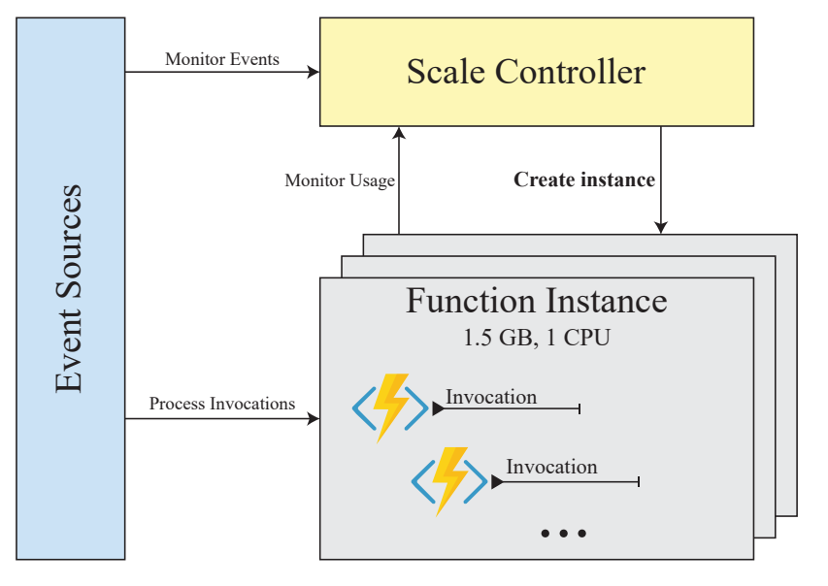
Function App architecture
Event Sources: These are the various inputs or triggers that initiate the execution of a function. Event sources can include HTTP requests, timers, Azure Queue storage, Service Bus messages, or any other event sources supported by Azure Functions.
Source:
https://www.researchgate.net/publication/337362540_FaaS_Orchestration_of_Parallel_Workloads

Slide 15
Function App architecture
Scale Controller: The scale controller monitors the incoming events and determines if more function instances are needed based on the number of events and the current usage. It plays a critical role in scaling the application dynamically.
Monitor Events: The scale controller continuously monitors the events coming from various sources.
Monitor Usage: It also keeps an eye on the resource usage of existing function instances to determine if additional instances need to be created.
Source:
https://www.researchgate.net/publication/337362540_FaaS_Orchestration_of_Parallel_Workloads

Slide 16
Function App architecture
Function Instances: These are the actual running environments where your function code executes. Each instance is allocated a certain number of resources, such as 1.5 GB of RAM and 1 CPU in the example shown in the image.
Create Instance: When the scale controller detects that more capacity is needed (based on event load and current usage), it creates new function instances to handle additional workload.
Process Invocations: Each function instance can handle multiple invocations of functions, meaning it can run your function code multiple times for different events in parallel, depending on the resources available.
Source:
https://www.researchgate.net/publication/337362540_FaaS_Orchestration_of_Parallel_Workloads

Slide 17
Function App architecture
Invocation: This represents each execution of a function, triggered by an event. Multiple invocations can occur on a single function instance, provided there are enough resources.
Source:
https://www.researchgate.net/publication/337362540_FaaS_Orchestration_of_Parallel_Workloads

Slide 18
“So, what about PowerShell?.”

Slide 19
Function App architecture
PowerShell functions can be triggered by various event sources, such as HTTP requests, timers, messages in Azure Queue Storage, or Service Bus, among others. The specific event that triggers the function is defined during the function's setup.
Source:
https://www.researchgate.net/publication/337362540_FaaS_Orchestration_of_Parallel_Workloads

Slide 20
Function App architecture
The scale controller monitors the incoming events from the triggers. When using the PowerShell runtime, the scale controller doesn't change its behavior; it still watches for the number of incoming events and the load on existing instances.
Source:
https://www.researchgate.net/publication/337362540_FaaS_Orchestration_of_Parallel_Workloads

Slide 21
Function App architecture
When an event triggers a PowerShell function, Azure Functions spins up a function instance that has the PowerShell runtime environment.
This instance includes all the necessary PowerShell modules and the Azure Functions modules needed to execute the PowerShell script.
Source:
https://www.researchgate.net/publication/337362540_FaaS_Orchestration_of_Parallel_Workloads

Slide 22
Function App architecture
When an event triggers the function, the PowerShell script associated with the function is executed. The script can use PowerShell commands and modules to perform tasks like managing Azure resources, sending emails, querying databases, etc.
Source:
https://www.researchgate.net/publication/337362540_FaaS_Orchestration_of_Parallel_Workloads

Slide 23
Function App architecture
The scale controller dynamically adjusts the number of PowerShell function instances based on the workload. If more events are incoming than a single instance can handle, Azure Functions will automatically create more instances with the PowerShell runtime to balance the load.
Source:
https://www.researchgate.net/publication/337362540_FaaS_Orchestration_of_Parallel_Workloads

Slide 24

PowerShell considerations
A PowerShell Azure function (function) is represented as a PowerShell script that executes when triggered.
Each function script has a related function.json file that defines how the function behaves, such as how it's triggered and its input and output parameters.
All functions in a function app must share the same language.
You choose the language of functions in your function app when you create the app.
Azure Function Apps have specific timeout durations depending on the hosting plan.
The functionTimeout property in the host.json file controls the timeout for function executions.

Slide 25


Triggers and bindings
Triggers
A trigger defines how a function is invoked. Each function must have exactly one trigger. Triggers have associated data, which is often provided as the payload of the function.
For example:
HTTP Trigger: Invokes the function via an HTTP request.
Timer Trigger: Invokes the function based on a schedule.
Queue Trigger: Invokes the function when a new message is added to a queue.
Bindings
Bindings are a way to declaratively connect another resource to the function. They can be input bindings, output bindings, or both. Bindings are optional, and a function might have one or multiple input and/or output bindings. For example:
Input Binding: Provides data to the function, such as reading a message from a queue.
Output Binding: Sends data from the function, such as writing a message to a queue.

Slide 26
Setting Up the Development Environment

Slide 27



Prerequisites
Visual Studio Code
Azure Functions extension for VS Code
Microsoft Azure Account

Slide 28
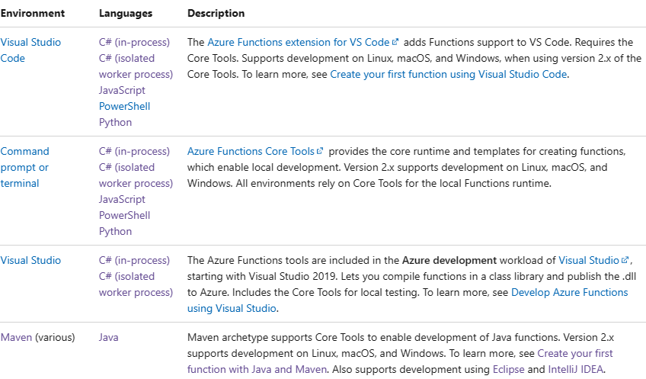
Local development
IDE support
Visual Studio
VS Code
Maven (Eclipse/ItelliJ)
Command line tooling
Core Tools
Azure CLI
Run locally
Functions runtime and language workers run locally
Emulators for Azure services

Slide 29
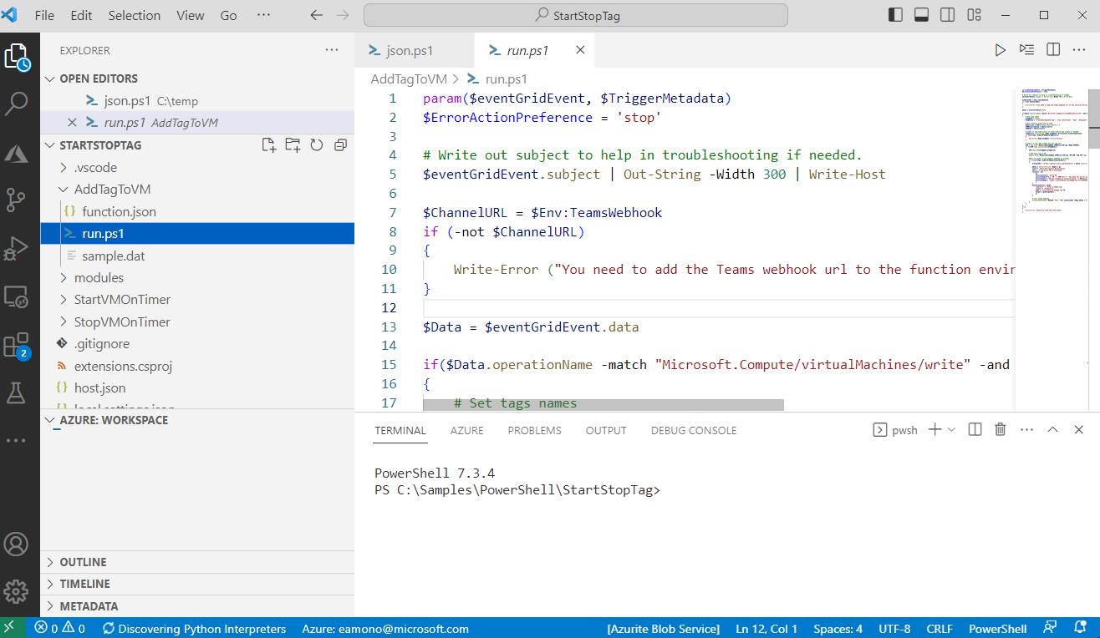
PowerShell
Event based automation
Respond to events on resources
Scheduled tasks
Process Azure alerts
Orchestrator external systems
Expose as an API
Hybrid Automation
Versions supported
PowerShell 7.2, 7.4 (Preview)

Slide 30
Creating Your First Azure Function with PowerShell

Slide 31
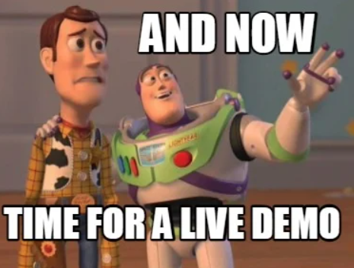
DEMO

Slide 32
Deploying to Azure

Slide 33

Demo
Events
Code
Create
Azure Storage Queue
PowerShell Function
Create Resource Group and Storage account
https://github.com/lukemurraynz/AzureFunctions_PowerShell

Slide 34
Azure Function PowerShell related files
File | Notes
host.json | This file contains global configuration options that affect all functions in the function app. It includes settings for logging, extension bundles, managed dependencies, and concurrency.
local.settings.json | This file is used to store app settings, connection strings, and other settings used by your function app when running locally. It is not deployed to Azure.
profile.ps1 | This PowerShell script is executed every time your Function App has a "cold start." It can be used to define helper functions, run commands, or specify environment variables. It includes code to authenticate with Azure PowerShell using Managed Service Identity (MSI).
requirements.psd1 | This file specifies the PowerShell modules that your function app depends on. The Azure Functions runtime will automatically install these modules when your function app starts.
run.ps1 | This PowerShell script contains the code that runs when the function is triggered.

Slide 35
DEMO

Slide 36
Conclusion

Slide 37

Azure Functions is an open-source project Functions runtime and all extensions are fully open-source
Azure Functions Core Tools lets you develop and test your functions on your local computer from the command prompt or terminal, and the local functions can connect to live Azure services
+
Learn more | https://github.com/Azure/Azure-Functions

Slide 38
Architecting for Azure

Slide 39

Azure Functions Hosting Options

Slide 40

Hosting options flexibility
Public preview
Flex Consumption
Pick the Functions plan that matches your business needs and deploy the same code to multiple targets—from serverless pay-per-execution to dedicated hosting options.
General availability
App service
Container Apps
Elastic Premium

Slide 41
Flex Consumption
Scale and throughput on your own terms with instance size choice, concurrency control, and fast and large scale out
Reach VNet secured services and secure your Function apps behind virtual networks
Scale to zero and only pay while there’s functions executions or for optional always ready instances, with no maximum Function execution time
Use Azure Functions Flex Consumption plan in the following situations
Your solution requires fast scaling and high throughput
You want to pay-as-you-go with networking features
Have control over concurrency-based scaling including http
Flex Consumption

Slide 42
Elastic Premium
Automatically scales based on demand using pre-warmed workers, which run multiple function applications with no delay after being idle, runs on more powerful instances, and connects to virtual networks
Use Azure Functions Premium plan in the following situations
Your function apps run continuously, or nearly continuously
You have a high number of small executions and a high execution bill, but low GB seconds
You need larger CPU or memory options
Multiple function apps per plan for optimal usage of compute
Dependency on Windows like .NET Framework or Windows APIs
Elastic Premium

Slide 43
App Service dedicated plans
Run your functions within an App Service plan at regular App Service plan rates
Best for long-running scenarios where Durable Functions can't be used
Consider an App Service plan in the following situations
You have existing, underutilized App Service instances that are already running web apps
Co-locate web apps and function apps on the same plan
Dependency on Windows like .NET Framework or Windows APIs
Predictive scaling and costs are required
Require large compute/memory options
App Service

Slide 44
Container Apps environment
Best for building solutions that requires Functions as containers packaged with Linux only images and functions runtime
Azure Container Apps Pricing with workload profiles that supports consumption(scale to zero) and dedicated with large range of CPU/memory options along with GPUs
Consider Container Apps for following situations:
Your solution requires containers and Functions to work seamlessly together
Common networking, logging for all your apps within the container app environment
Integrate with Dapr for service-to-service calls and other integration scenarios between the microservices
Container Apps Environment

Slide 45
Architecting for Azure
1
2
3
Cloud Adoption Framework
Azure Architecture Center
Well-Architected Framework
Proven guidance and best practices that help you confidently adopt the cloud and achieve business outcomes.
Guidance for architecting solutions on Azure using established patterns and practices
A set of quality-driven tenets, architectural decision points, and review tools intended to help solution architects build a technical foundation for their workloads.
https://learn.microsoft.com/azure/cloud-adoption-framework/
https://learn.microsoft.com/azure/architecture/
https://learn.microsoft.com/azure/well-architected/

Slide 46
The time is now, go build!

